Slide 1
Support Vector Machine
Session 5

Slide 2
Introduction
In machine learning, support-vector machines (SVMs, also support-vector networks) are supervised learning models with associated learning algorithms that analyze data used for classification and regression analysis.
Developed at AT&T Bell Laboratories by Vapnik with colleagues (Boser et al., 1992, Guyon et al., 1993, Vapnik et al., 1997)

Slide 3
Topics
Support Vectors
Hyperplanes
Marginal Distance
Linear Separable
Non Linear Separable

Slide 4
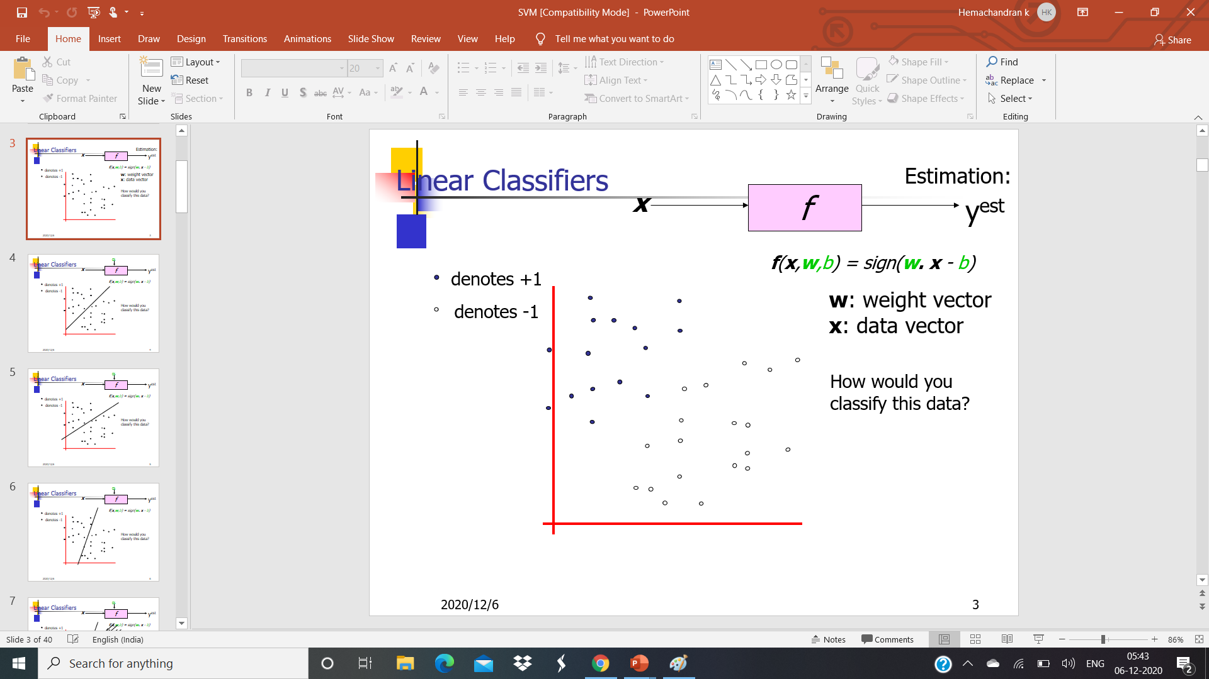

Slide 5
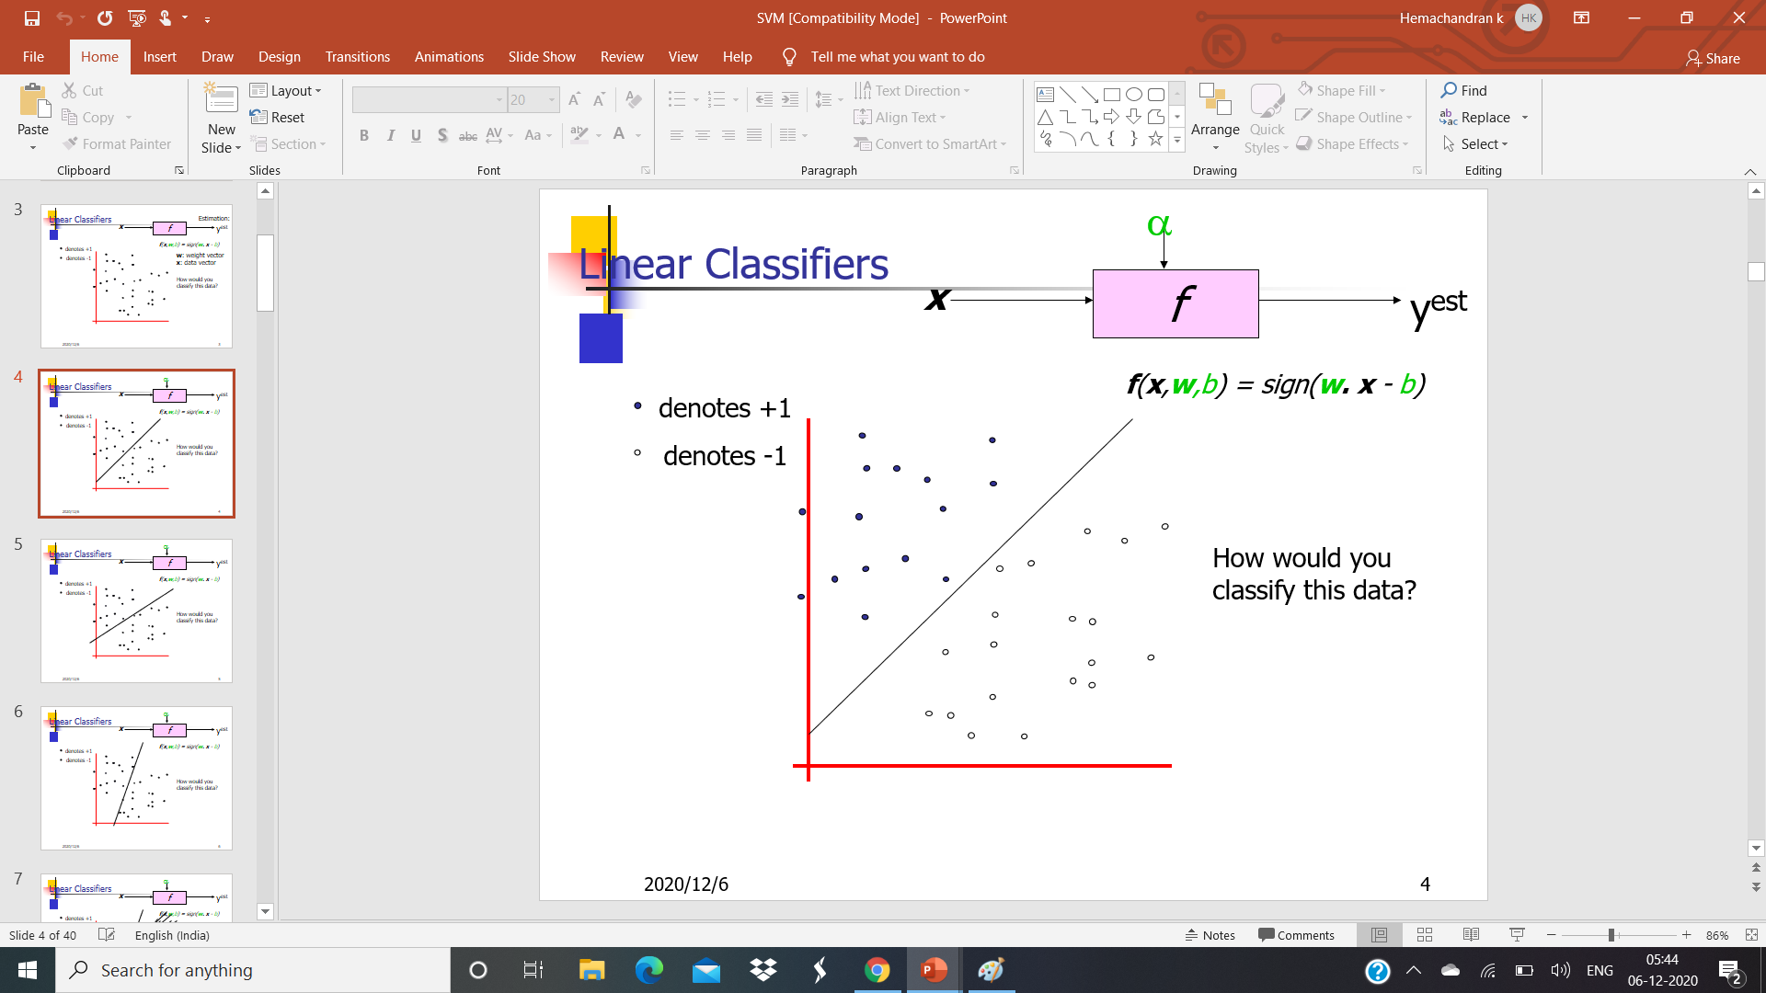

Slide 6
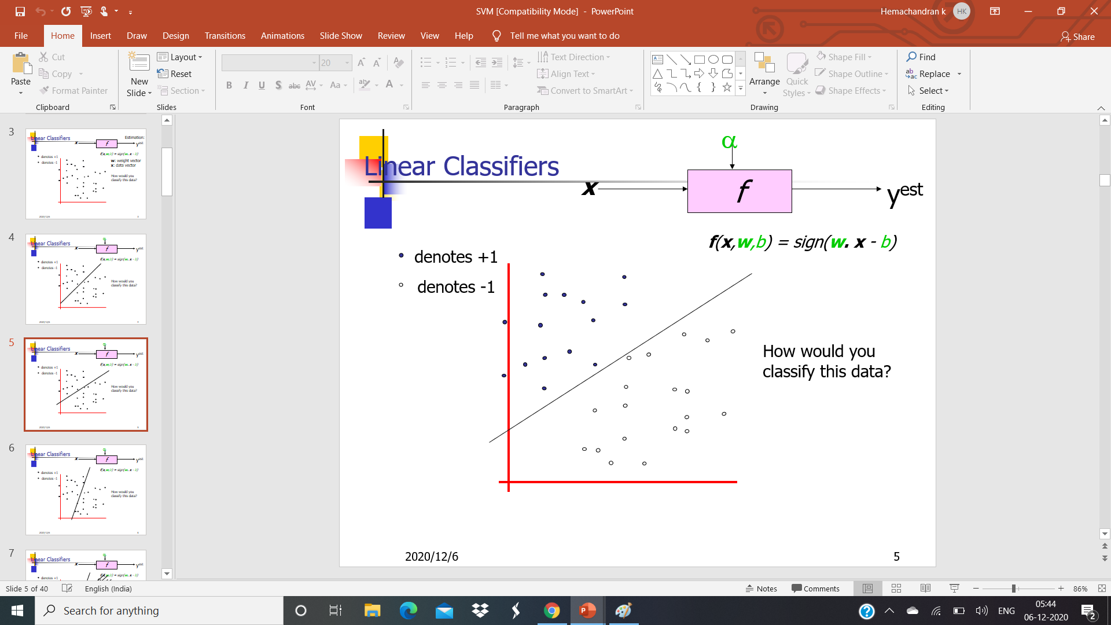

Slide 7
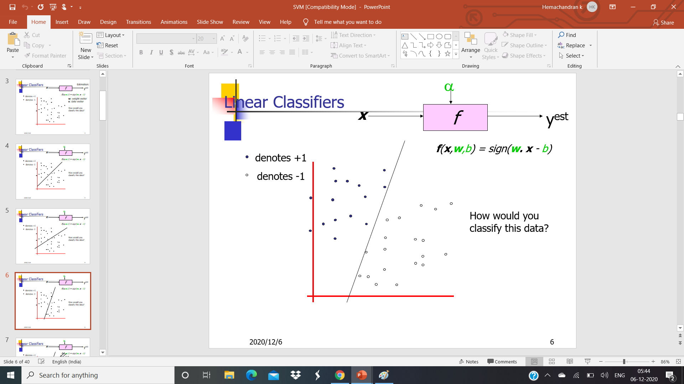

Slide 8
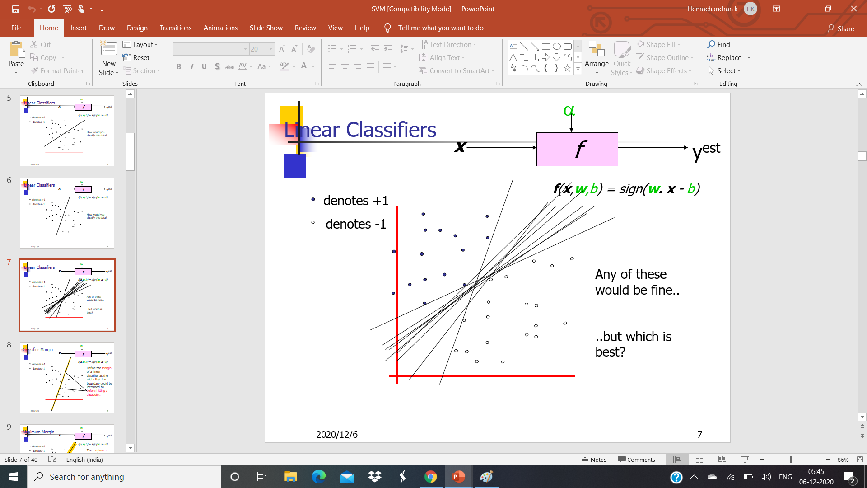

Slide 9
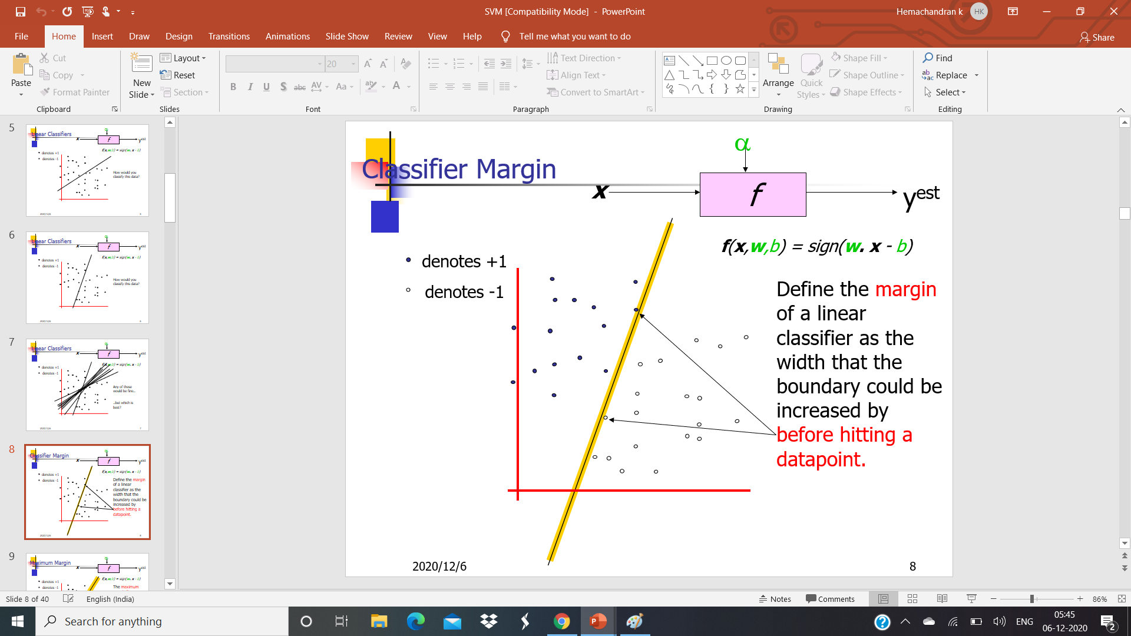

Slide 10
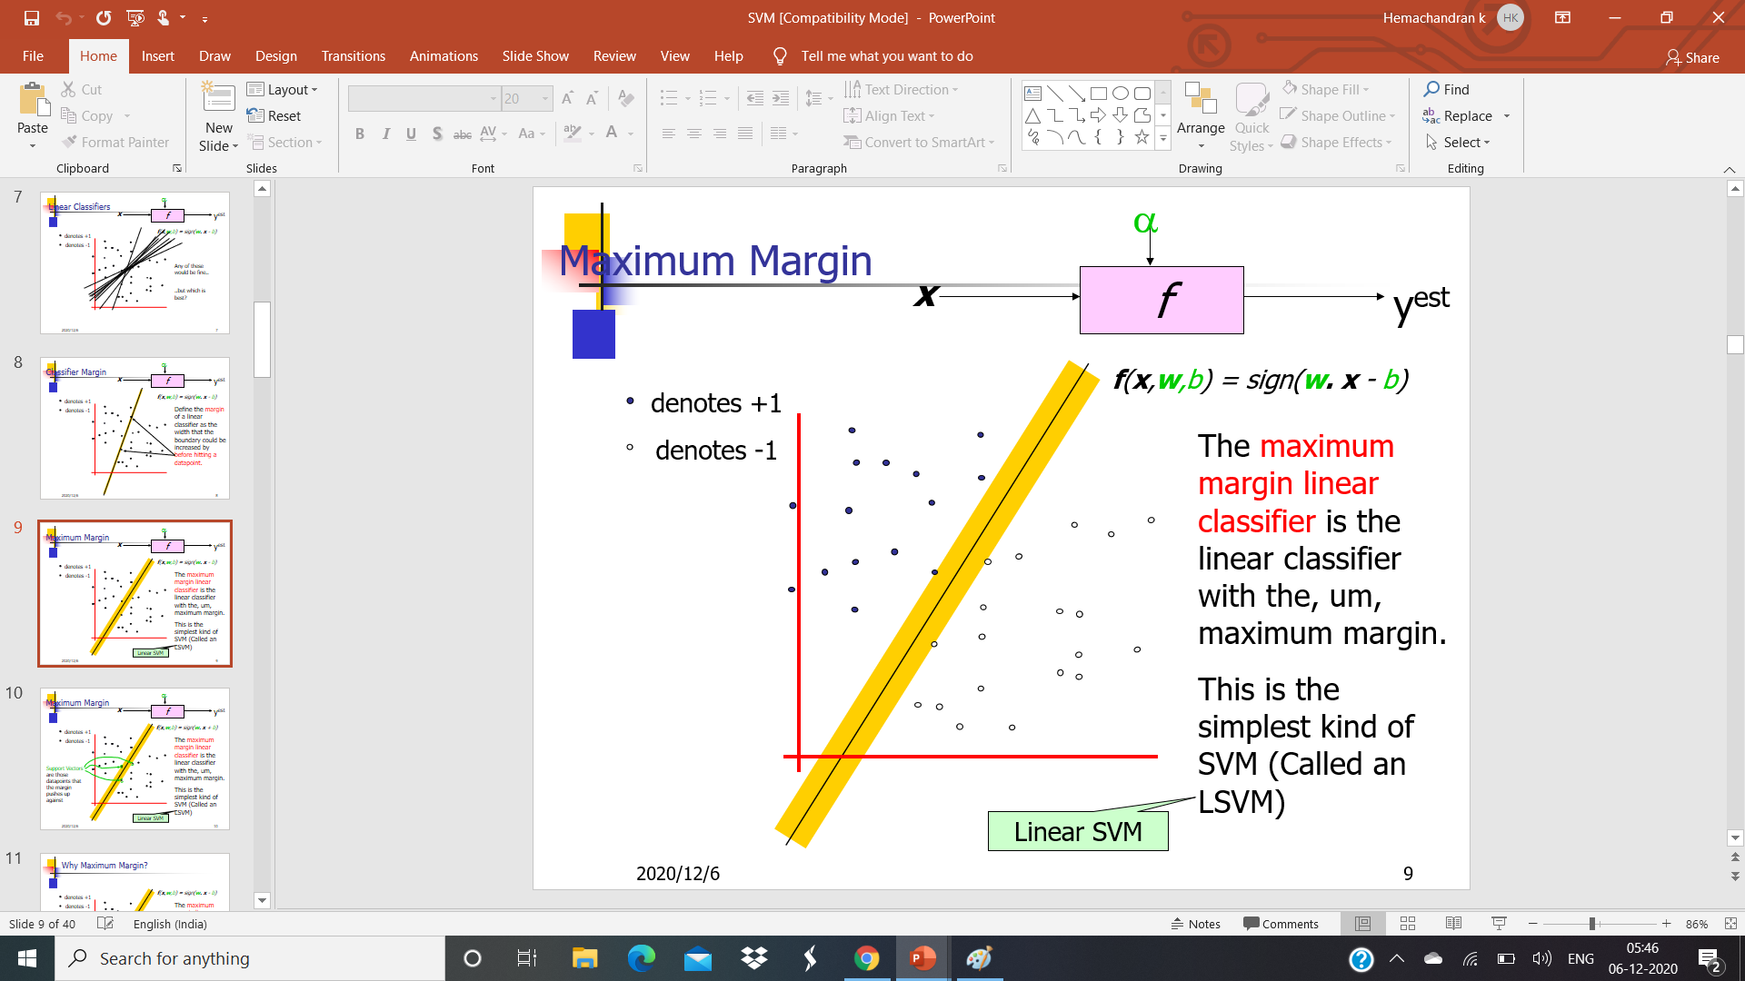

Slide 11
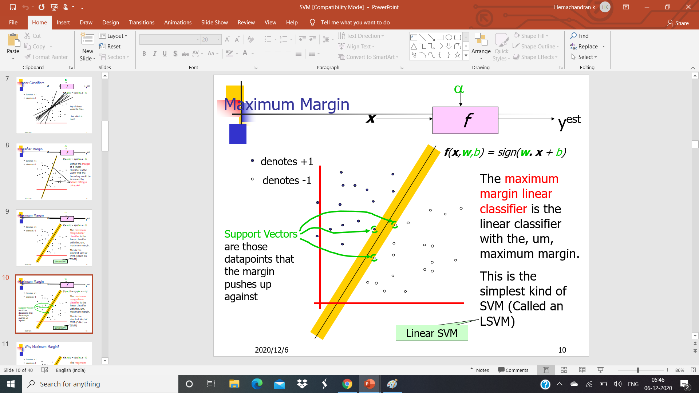

Slide 12
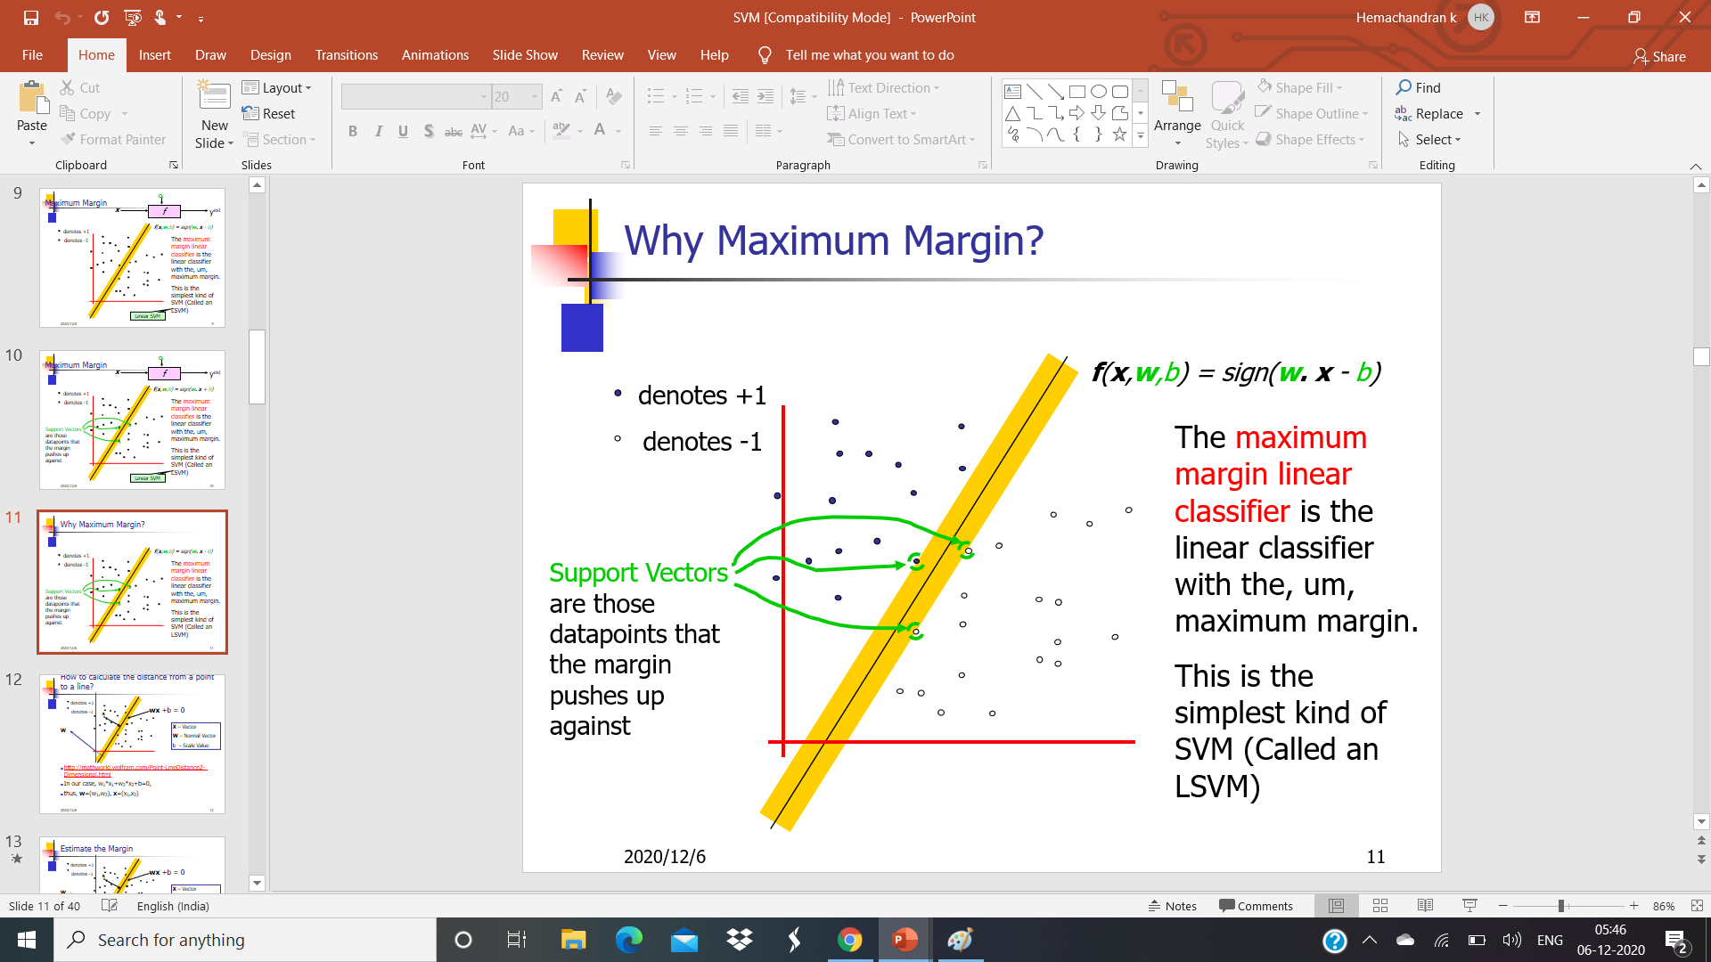

Slide 13
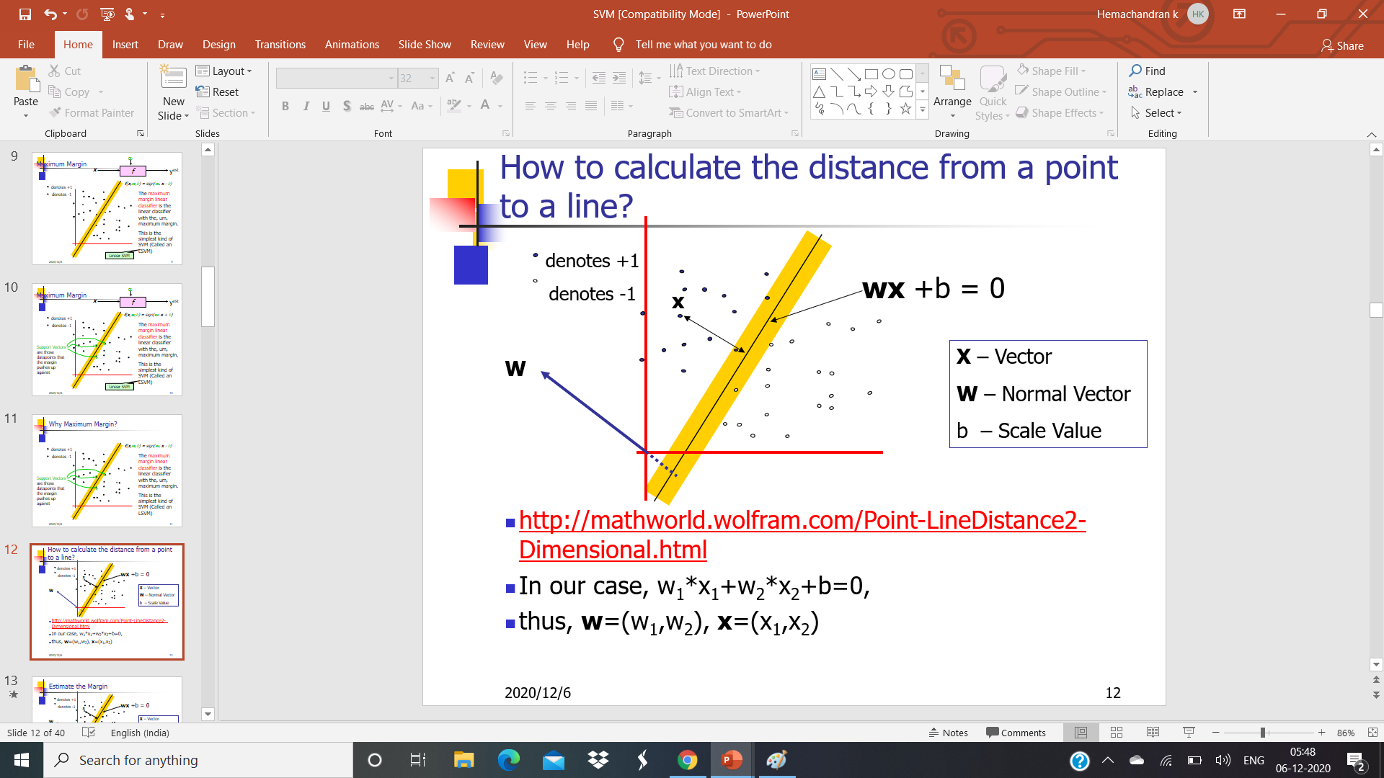

Slide 14
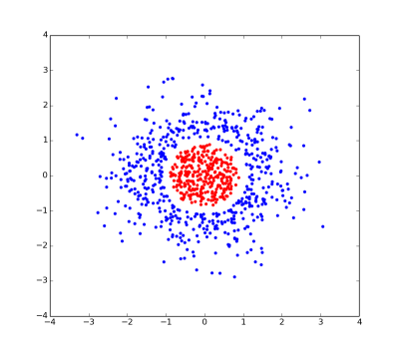
Non Linear Separable
SVM Kernels is used to convert 2D to High dimensional so that we can separate the classes with a plane.

Slide 15
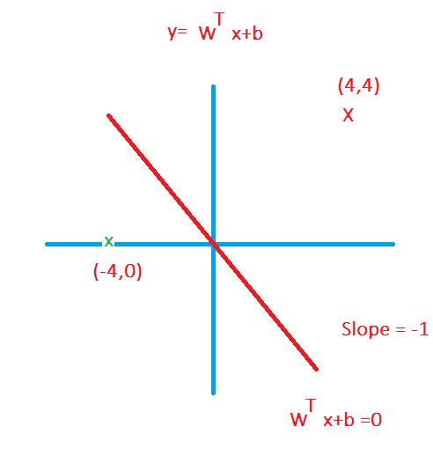
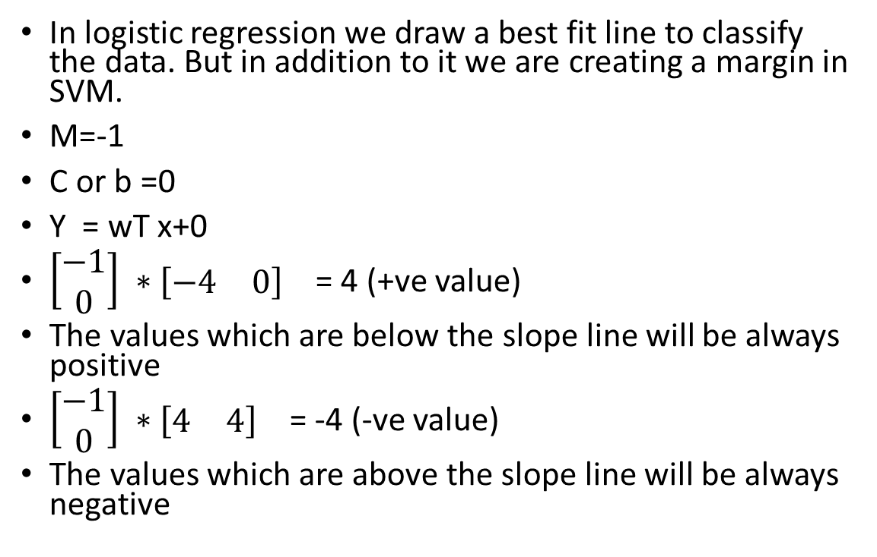
Equation
In logistic regression we draw a best fit line to classify the data. But in addition to it we are creating a margin in SVM.
M=-1
C or b =0
Y = wT x+0
$\left[\begin{matrix}−1 \\ 0\end{matrix}\right] ∗[\begin{matrix}−4 & 0\end{matrix}]$ = 4 (+ve value)
The values which are below the slope line will be always positive
$\left[\begin{matrix}−1 \\ 0\end{matrix}\right] ∗[\begin{matrix}4 & 4\end{matrix}]$ = -4 (-ve value)
The values which are above the slope line will be always negative

Slide 16
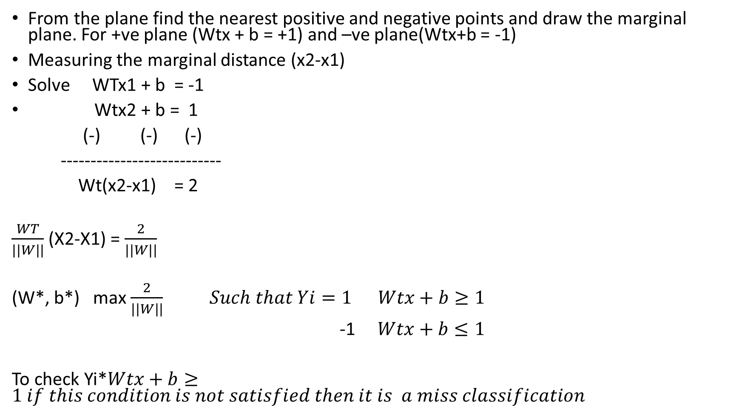
From the plane find the nearest positive and negative points and draw the marginal plane. For +ve plane (Wtx + b = +1) and –ve plane(Wtx+b = -1)
Measuring the marginal distance (x2-x1)
Solve WTx1 + b = -1
Wtx2 + b = 1
(-) (-) (-)
---------------------------
Wt(x2-x1) = 2
$\frac{WT}{|\left|W\right||}$ (X2-X1) = $\frac{2}{|\left|W\right||}$
(W*, b*) max $\frac{2}{|\left|W\right||} Such that Yi=1 Wtx+b≥1$
-1 $Wtx+b≤1$
To check Yi*$Wtx+b≥1 if this condition is not satisfied then it is a miss classification$

Slide 17

Real time scenario
(W*, b*) = min $\frac{2}{|\left|W\right||}+Ci \sum_{i=1}^{n}{∅i}$
Ci = How many errors (Regularization)
$∅i$ = Value of the error (distance)

Slide 18
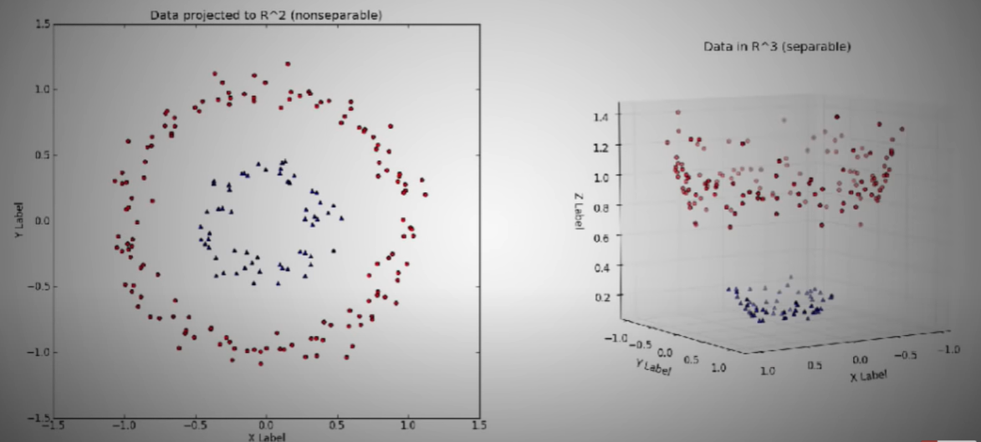
Non-linear Separable

Slide 19
